Slide 1



Dietary: a Cloud-based Nutriment & Fitness Assistant(fact-based)
Android App for Bangladeshi Youths.
CSE 299.7
Presentation Week : 02
Presentation Topic : Background Study
Presenting By : Group 1
Date : 30-07-2020

Slide 2


Project analysis slide 2
Agenda
Preview
What’s new!
Background study
- Market research
- Similar works
- Scholarly Articles
Procedure
Tool’s
What’s next?
Conclusion
References
Q/A segment

Slide 3

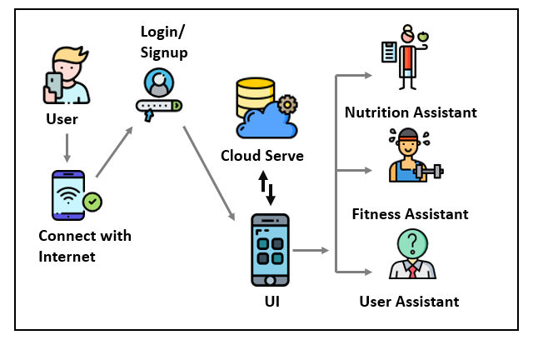
Project analysis slide 2
Preview
Proposed Idea & purpose
System Overview
Application Overview
Work Cycle
System Overview

Slide 4

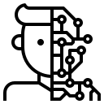



Project analysis slide 2
What’s New
Nutrition
Assistant
User
Assistant
Fitness
Assistant
+
=
Machine
Learning
Trained
Data with
appropriate
Algorithm
ML trained Recommender Application

Slide 5

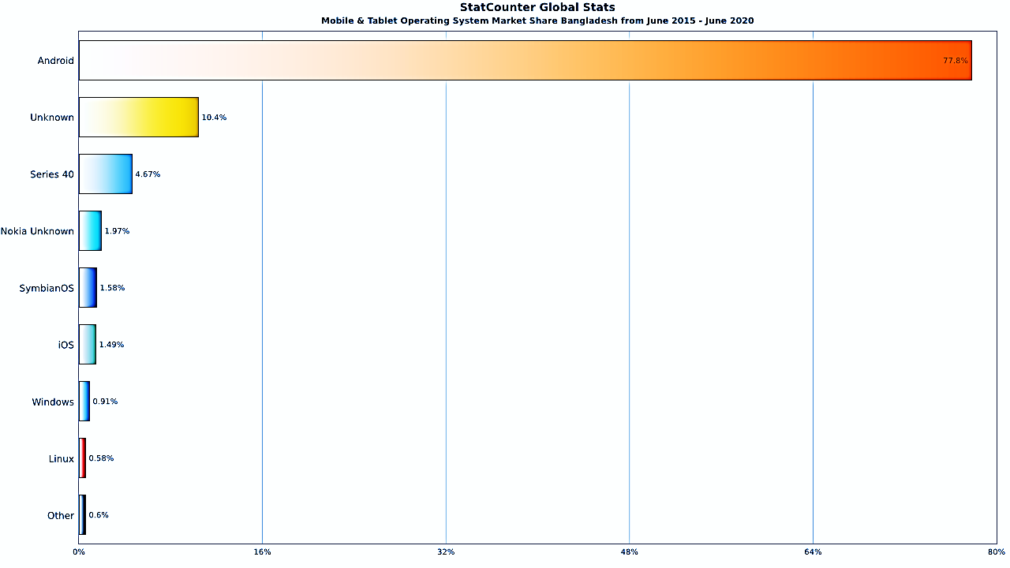
Project analysis slide 2
Background Study [Market Research]
Why Android Application ?

Slide 6
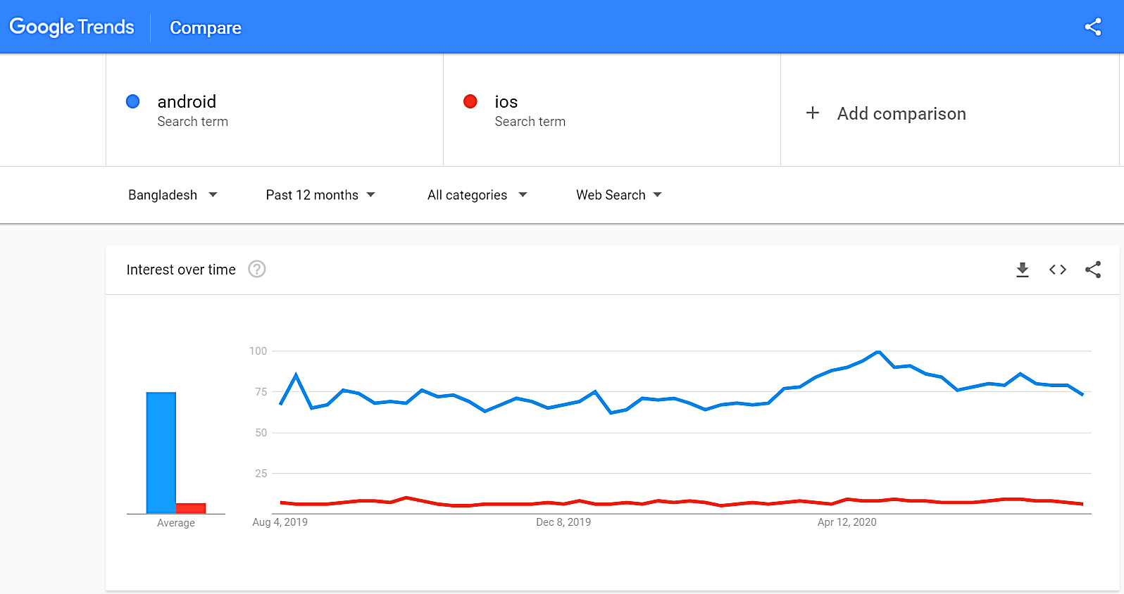
Project analysis slide 2
Background Study [Market Research]
(Continued)

Slide 7

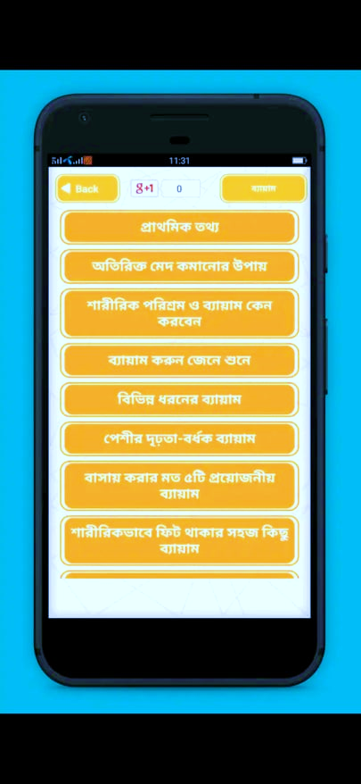
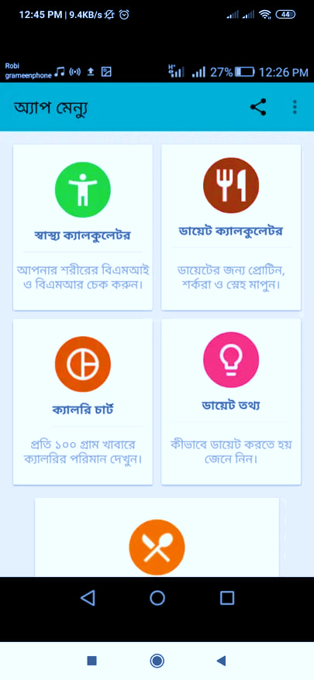
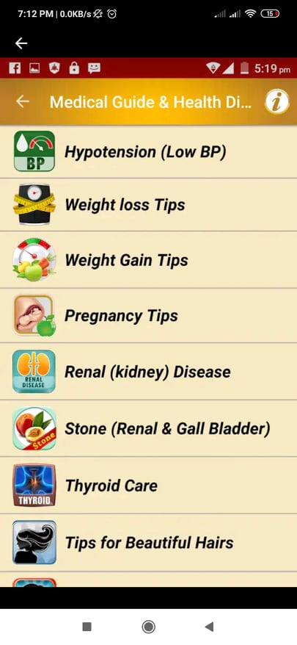
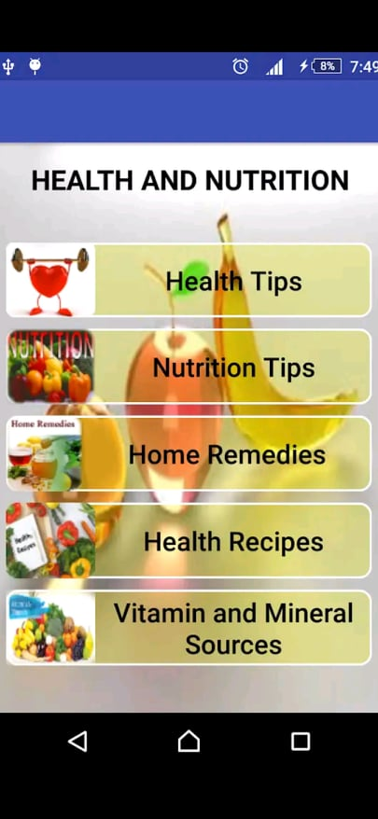
Project analysis slide 2
Background Study [Similar works]
Google Play
100K+ download
Rating 4.0+
Comments in 2020
Healthy Diet foods & Fitness Help
Physical Exercise
Calorie and Diet
4.4
4.2
4.5
Health and Nutrition
4.6

Slide 8
Project analysis slide 2
Background Study [Similar works]
(Continued)
Similar features :
Dissimilar features :
BMI Calculator
Diet Plan
Calorie Chart
Workout Plan
Treatments
Home Remedies
Food Recipes
Diseases information

Slide 9

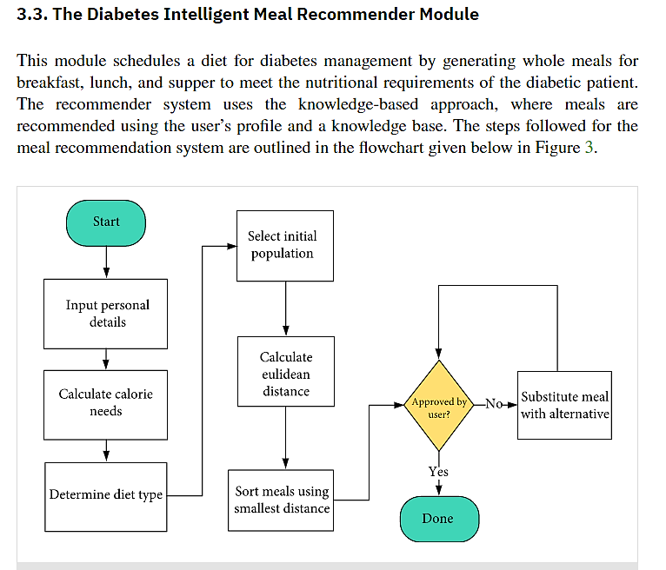
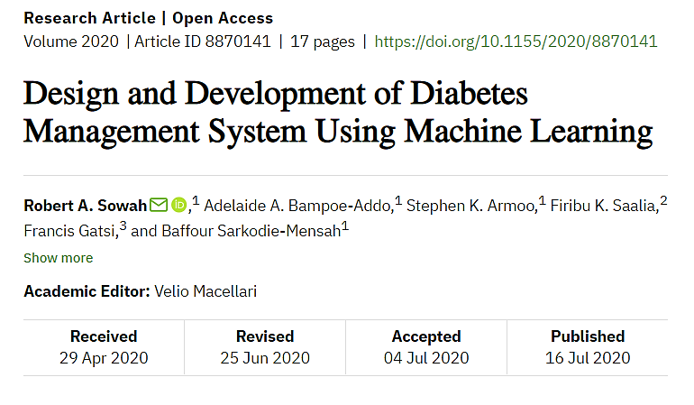
Project analysis slide 2
Background Study [Scholarly Articles]

Slide 10
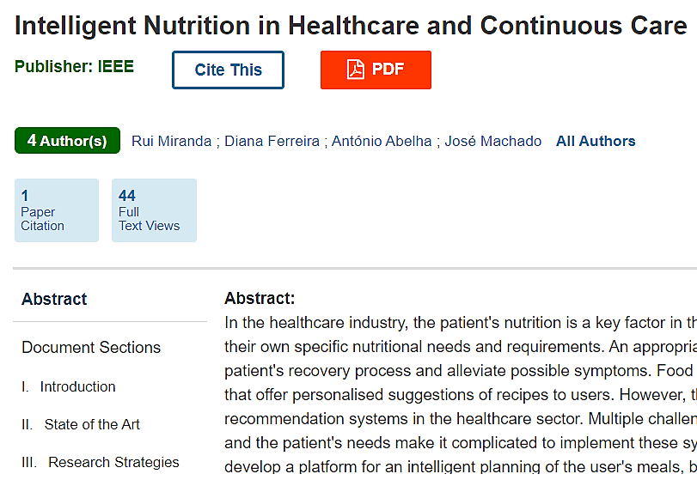
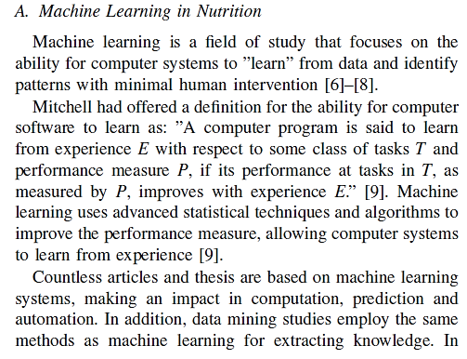
Project analysis slide 2
Background Study [Scholarly Articles]
(continued)

Slide 11







Project analysis slide 2
Tool’s
Core Platform & Language :
Android Studio
Framework’s :
Java
Dilogflow
TensorFlow Lite
Backend Support :
Language :
Firebase
- Firebase Authentication
- Cloud Firestore
Python

Slide 12


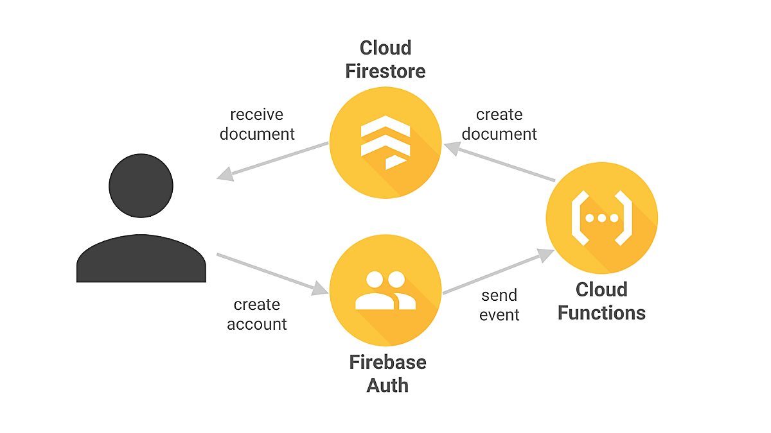
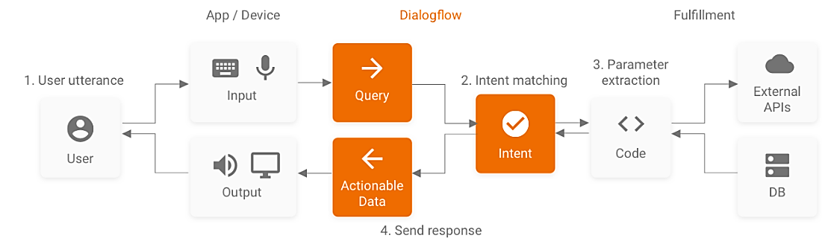
Project analysis slide 2
Procedure
How this application is going to work?
How Firebase works?
.xml .Java
+
=
How Dialogflow works?

Slide 13
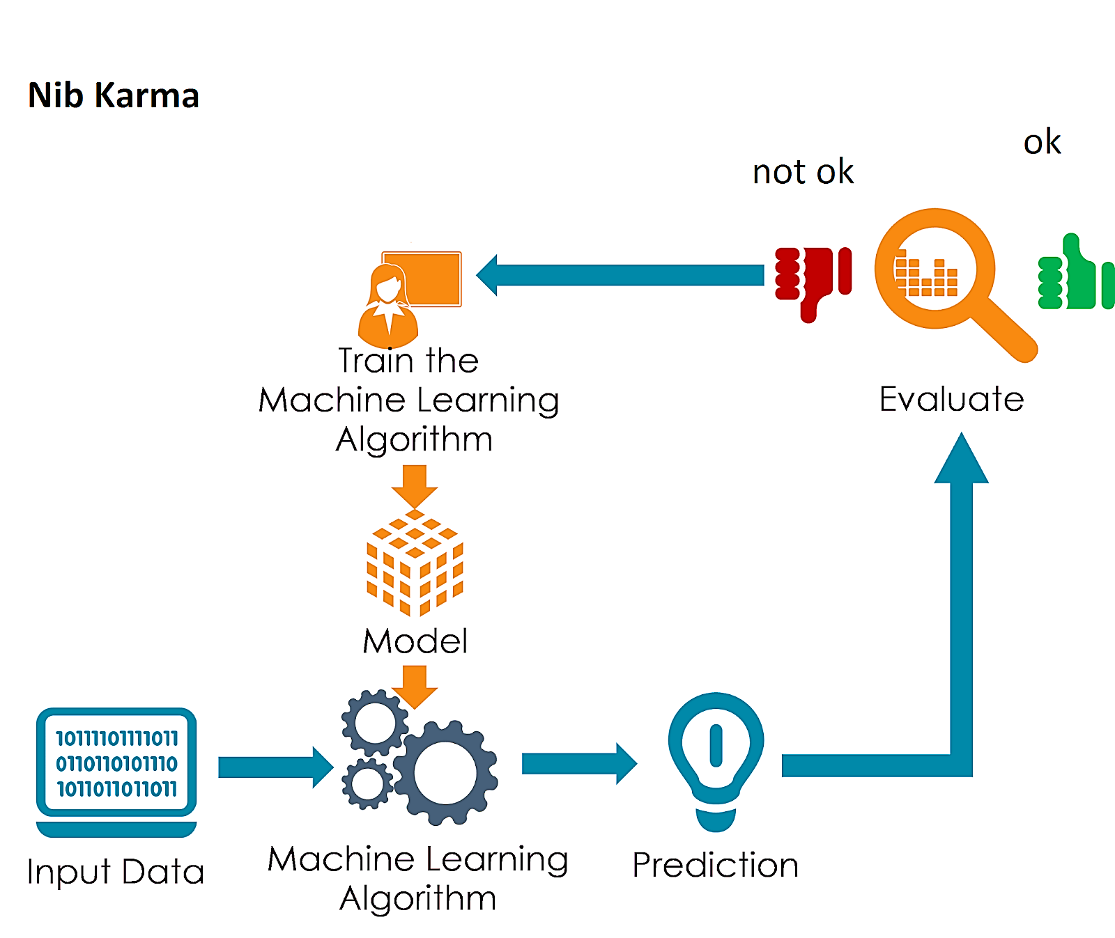
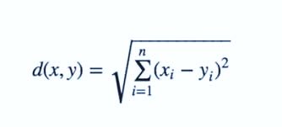
Project analysis slide 2
Procedure
How dose Machine Learning works?
Which algorithm going follow?
K-Nearest Neighbor (KNN) a basic classification algorithm of Machine Learning.

Slide 14

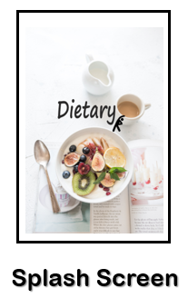
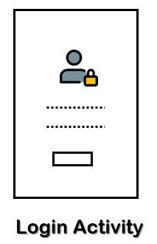
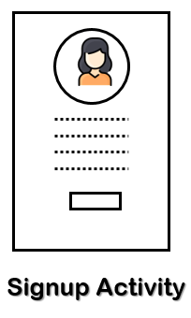
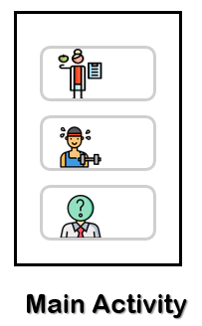
Project analysis slide 2
What’s Next?
Material Design & Authentication

Slide 15


Project analysis slide 2
Conclusion
Our future plan is to make this application
a complete ML trained Virtual Assistant.
Our motivation is not replacing real life
Nutritionist or Fitness Instructor.
Our main goal is speared Nutrition & Fitness
related consciousness & guiding
among regular life people through this App.

Slide 17

Project analysis slide 2
References
https://gs.statcounter.com/os-market-share/mobile-tablet/bangladesh/#monthly-201506-202006-bar
https://trends.google.com/trends/explore?geo=BD&q=android,ios
https://l.facebook.com/l.php?u=https%3A%2F%2Fplay.google.com%2Fstore%2Fapps%2Fdetails%3Fid%3Dcom.piroot.elcot.healthnutrition%26fbclid%3DIwAR3HMHu8spxbJBELIICFO7Y6h8ErH7EX2L5yqUku9n9yvbfu1K-02S-Rebo&h=AT3pxqtL3LY7COiR2YAl7-hTf4J81hSfT27Hz-7CoW1gNtIxsWWlgyhEEmZOBjYCzf_r6QRtRyR0uWM9c92invxd-7UNtHMhgyqXWayp0bcqsSeEcU5g59uuctAJK5APHV9uzg
https://l.facebook.com/l.php?u=https%3A%2F%2Fplay.google.com%2Fstore%2Fapps%2Fdetails%3Fid%3Dcom.blogspot.sakibhs.bmihealthadviserbangla%26fbclid%3DIwAR1bYVQ39Uj7Wpm_e8g1PXytS01rPmbQhVPw6irqB18bhWkMddY_e9UFQq0&h=AT3pxqtL3LY7COiR2YAl7-hTf4J81hSfT27Hz-7CoW1gNtIxsWWlgyhEEmZOBjYCzf_r6QRtRyR0uWM9c92invxd-7UNtHMhgyqXWayp0bcqsSeEcU5g59uuctAJK5APHV9uzg
https://l.facebook.com/l.php?u=https%3A%2F%2Fplay.google.com%2Fstore%2Fapps%2Fdetails%3Fid%3Dcom.medical.guide_health.diet.tips%26fbclid%3DIwAR3nRskagNJOL9ZgeD2TlOEOz85cLjQDj8lNAs_q_RS6ZQU3dJ1TixsjrGk&h=AT2A-bSD4kKO8SdqJZa_L_aHfR7md2OLRi8YtporQqarI83qqG_JqqrllnmmEPieA5LPaLHDQgnUM0q-8CgTm-I7SAhdVtcdn4AQYsUVZA6o7yozzNhk6SJbH_KlnWQyWGyG

Slide 18
Project analysis slide 2
References (Continued)
https://l.facebook.com/l.php?u=https%3A%2F%2Fplay.google.com%2Fstore%2Fapps%2Fdetails%3Fid%3Dcom.blogspot.sakibhs.bmihealthadviserbangla%26fbclid%3DIwAR3XhvVsE2rnZkAHali07QAJr4AvbXw86u_1XXbz5bKuMnbl0rFFwc1TIDM&h=AT206kTWZznHfFV0c6Skce6DZPytf9cK1c7S6TZLdywwVhi8E0n-E8ZyMhbAozYI1qLfjGV9iBmJNN8jiAP9i_g6sWzCeUT8L1Rcctvr0lBLiffsXvFv2mWiZaTXCJnHRvYB
Sowah, R., Bampoe-Addo, A., Armoo, S., Saalia, F., Gatsi, F. and Sarkodie-Mensah, B., 2020. Design and Development of Diabetes Management System Using Machine Learning. International Journal of Telemedicine and Applications, 2020, pp.1-17.
R. Miranda, D. Ferreira, A. Abelha and J. Machado, "Intelligent Nutrition in Healthcare and Continuous Care," 2019 International Conference in Engineering Applications (ICEA), Sao Miguel, Portugal, 2019, pp. 1-6, doi: 10.1109/CEAP.2019.8883496.
https://developer.android.com/studio/intro
https://firebase.google.com/docs/?gclid=Cj0KCQjwvIT5BRCqARIsAAwwD-QAGiwPgY2aac85b7g9zvzvdjR5gULh_w6C1CHXy0JNy6mYJso7Hr0aAk8aEALw_wcB
https://cloud.google.com/dialogflow/docs
https://www.tensorflow.org/lite

Slide 19


Feel free to rise……
Question’s ?
Or
Suggestion's !

